Slide 1
Comments on the midterm

Slide 2
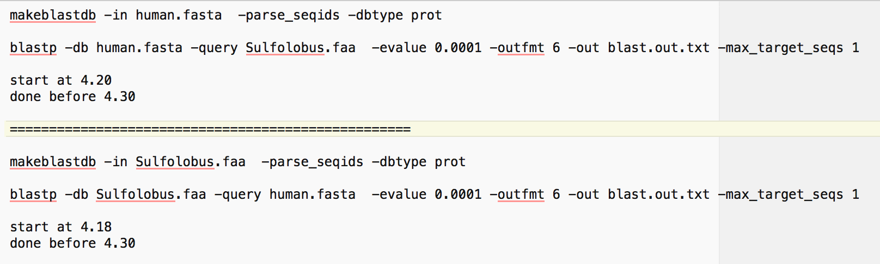
Command line blast
(essentially as in assignment 3 part B, using unmodified faa files)
Commands:

Slide 3
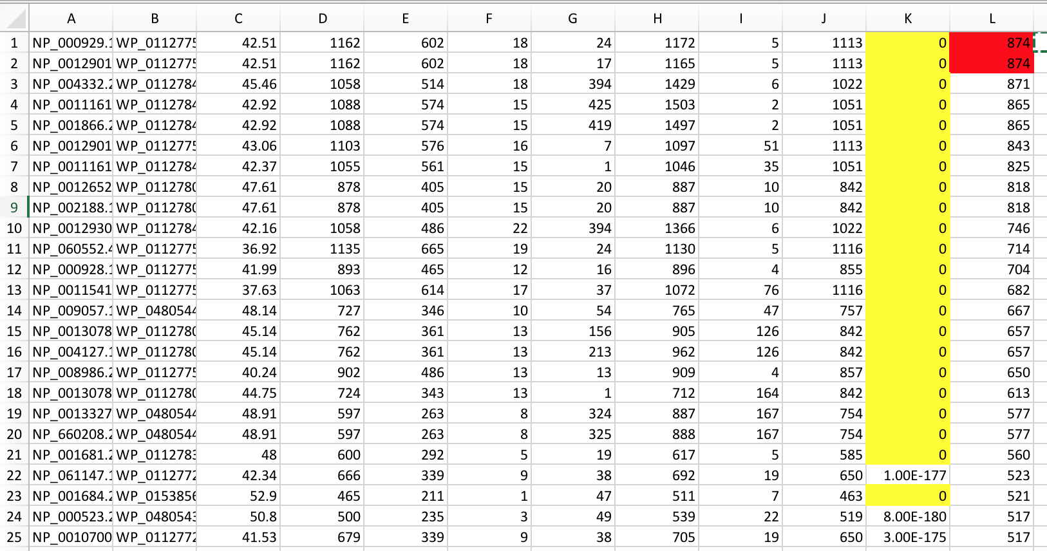
Blastp output sorted on bitscore (E-value = zero in yellow)
Sulfolobus proteins as DB
Sorting on bitscore or E-value works, although longer sequences have an advantage.

Slide 4
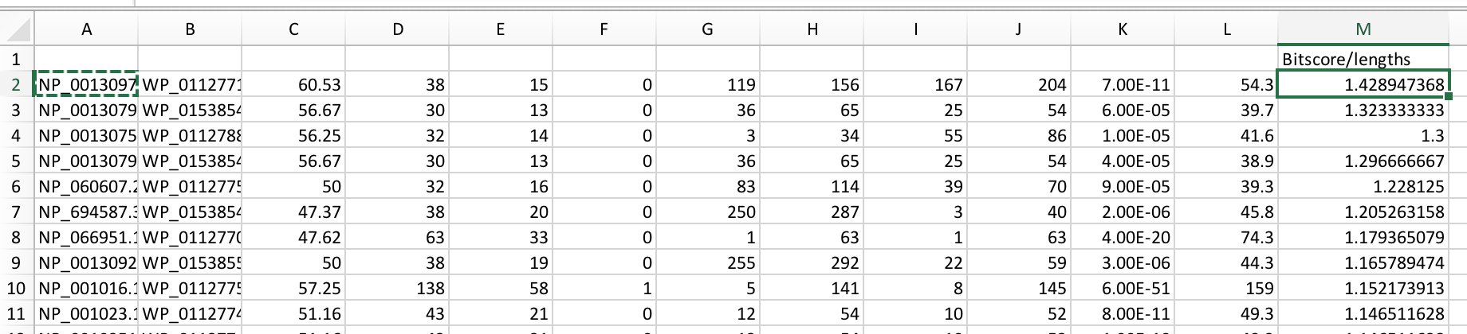
Sorting on bitscore/length does not work well (same problem as % id) – one gets a rather short sequence as match.

Slide 5
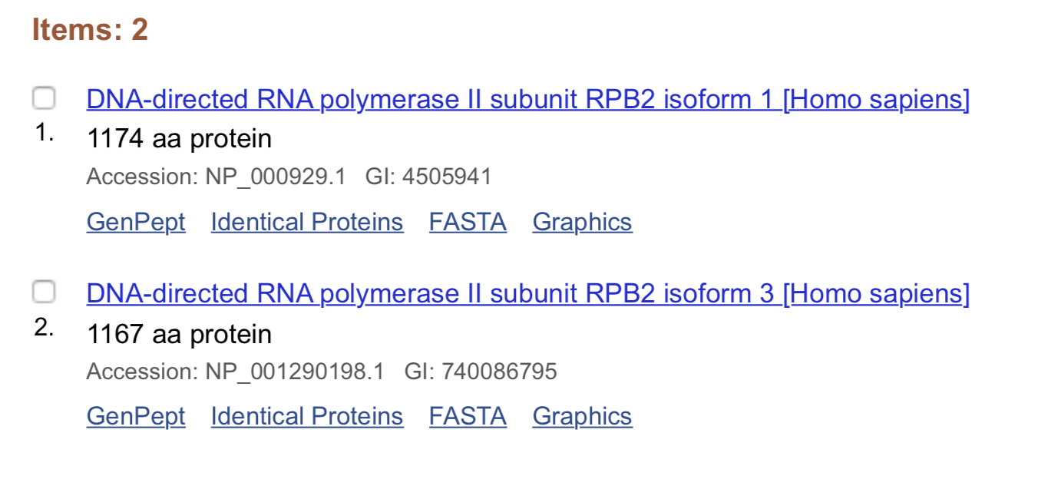

Slide 6
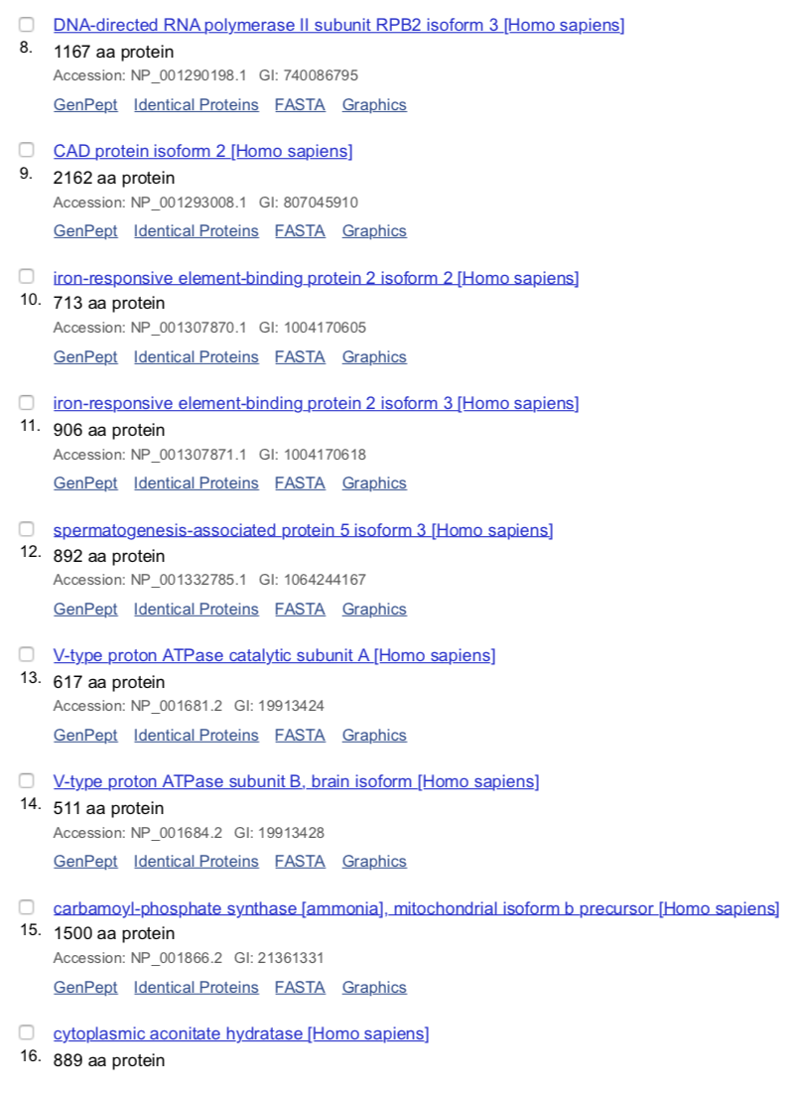
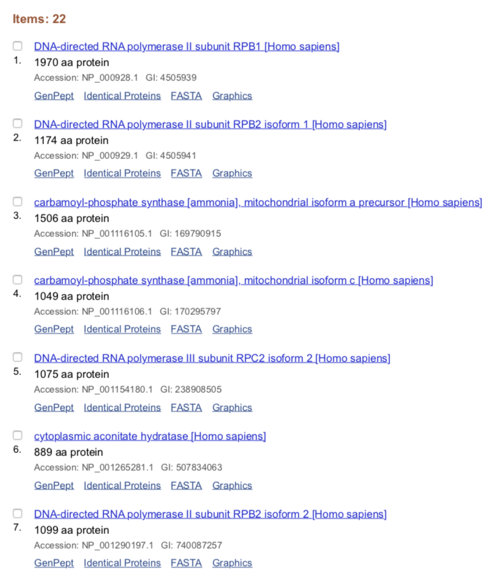
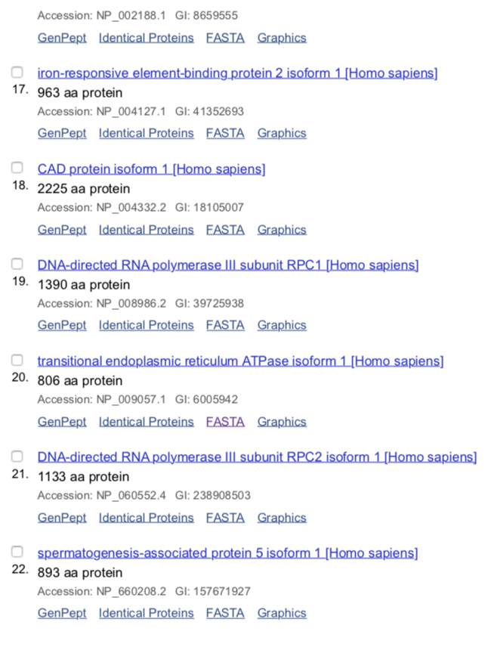
Queries with E-value zero (Sulfolobus as data bank)

Slide 7
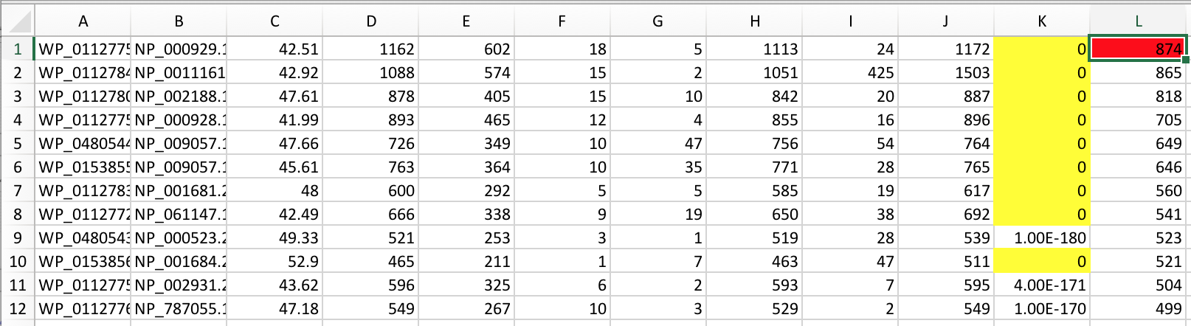
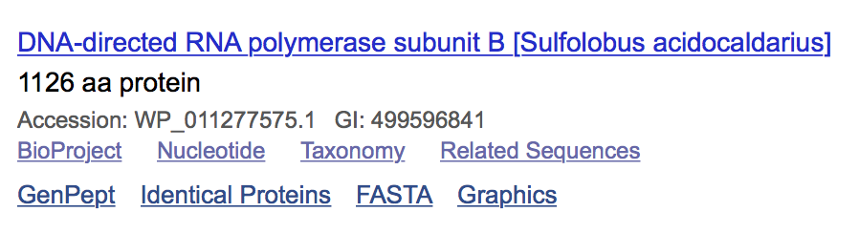
Blastp output sorted on bitscore (E-value = zero in yellow) Human proteins as DB
Sorting on bitscore or E-value works, although longer sequences have an advantage.

Slide 8
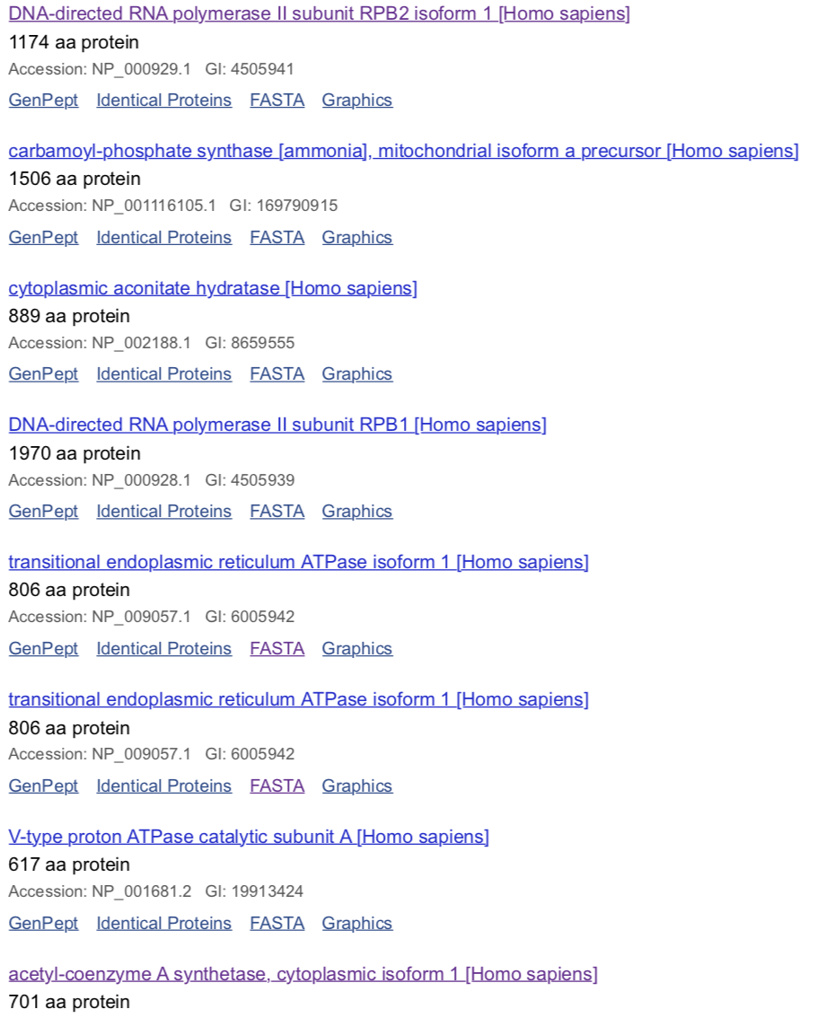
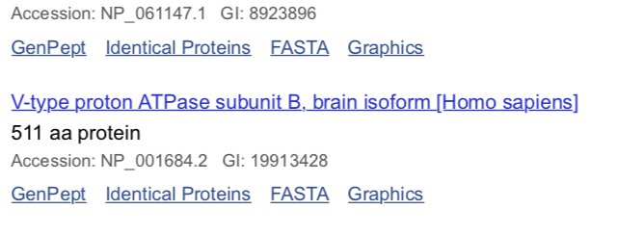
Queries with E-value zero (Human as data bank)

Slide 9
Plotting palindrome occurrences along a genome
(a slight modification of the TetraA.pl script discussed in the review session)

Slide 10
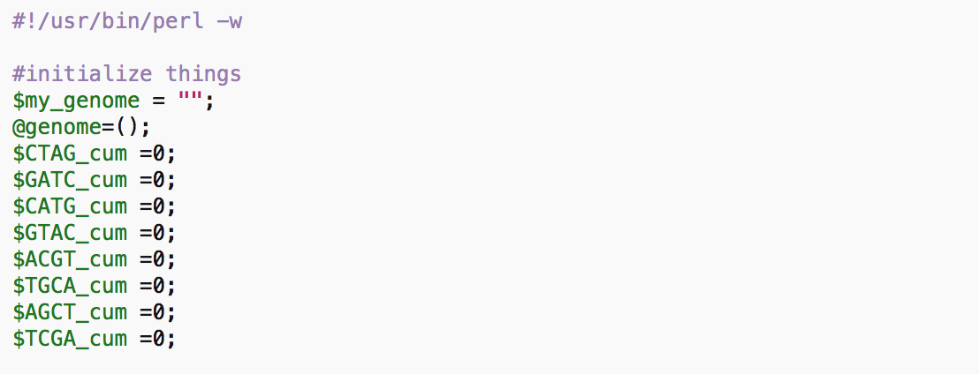

Slide 11
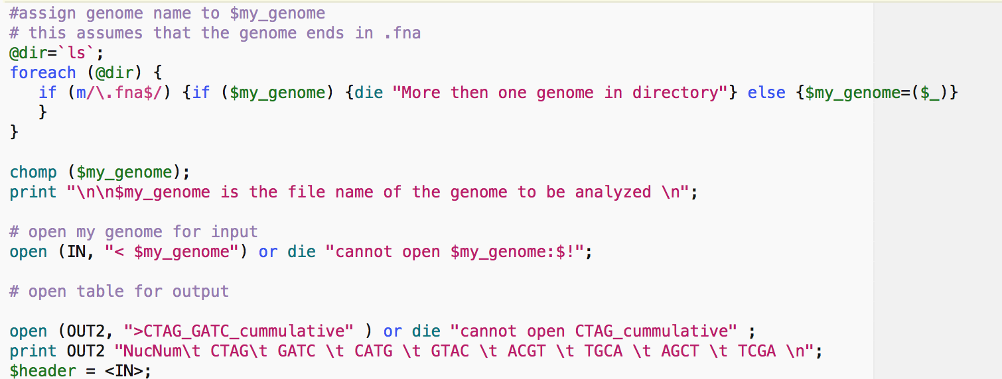

Slide 12
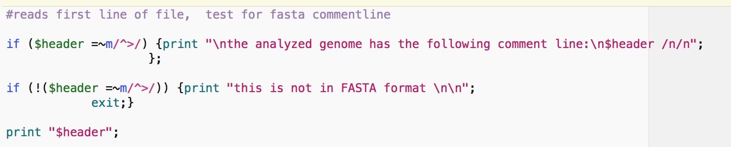

Slide 13
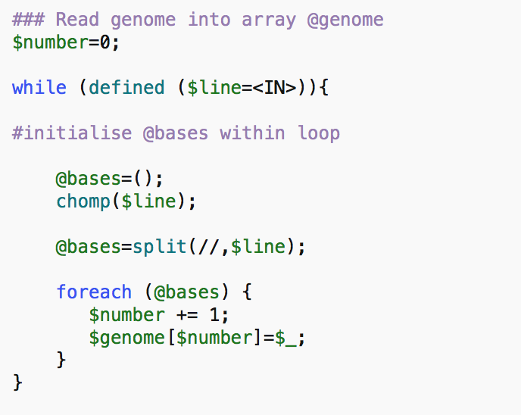
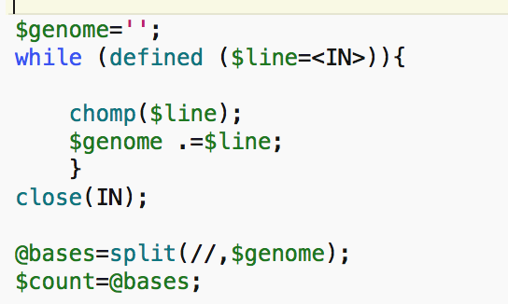
Or one could have concatenated the genome and split then, as in the TetraA.pl example:

Slide 14
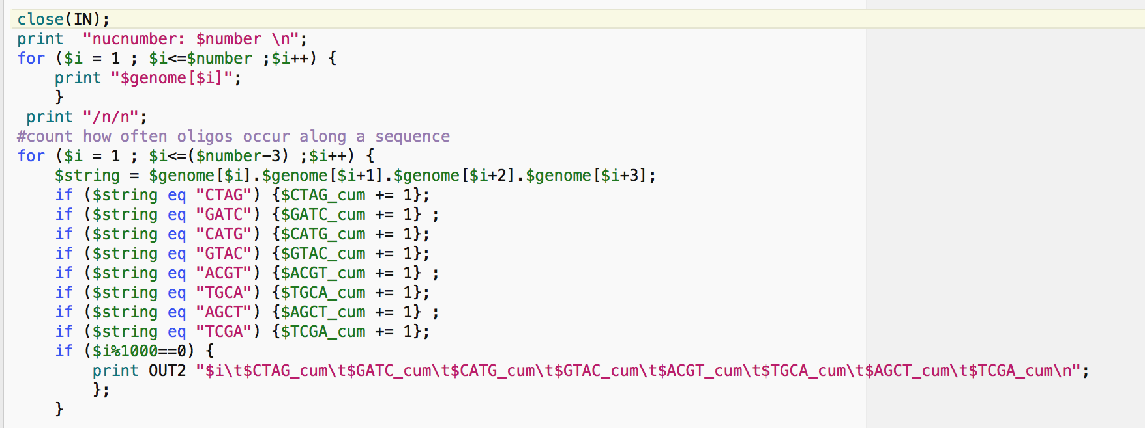
Print out only every 1000 (or more) nucleotides, else the file gets very large and Excel might encounter problems.

Slide 15
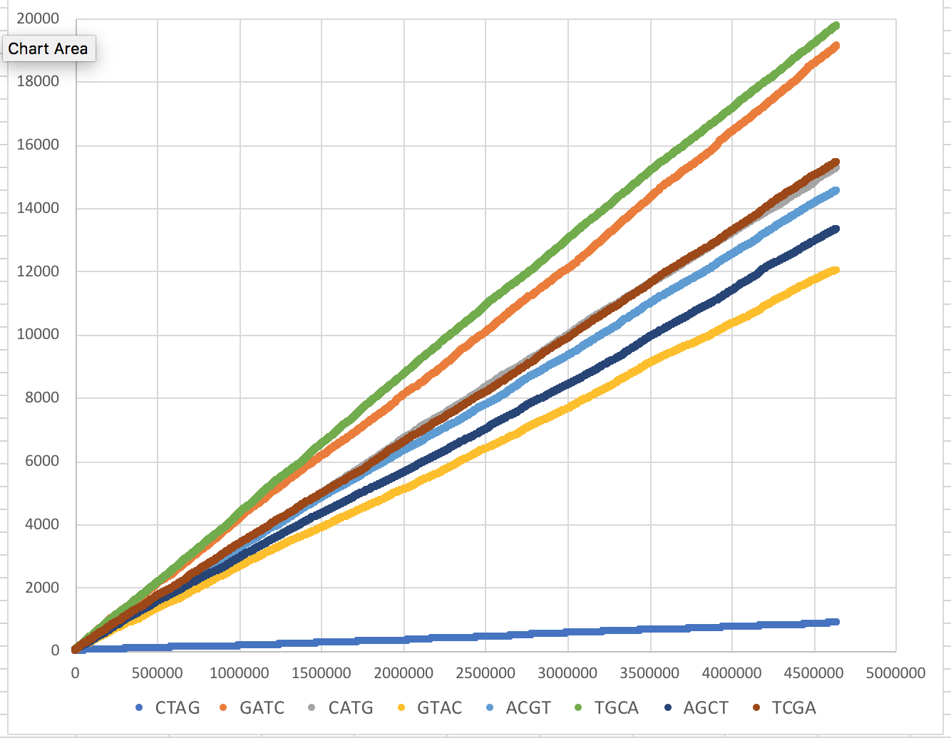
Cumulative Palindrome Occurrence along the E.coli K12 genome
.25^4*4,600,000=
~18,000

Slide 16
For Wednesday:
Write a to-do-list for your student project.

Slide 17
Terminology
Branches, splits, bipartitions
In a rooted tree: clades (for unrooted trees sometimes the term clann is used)
Mono-, Para-, polyphyletic groups, cladists and a natural taxonomy
The term cladogram refers to a strictly bifurcating diagram, where each clade is defined by a common ancestor that only gives rise to members of this clade. I.e., a clade is monophyletic (derived from one ancestor) as opposed to polyphyletic (derived from many ancestors). (Note: you do need to know where the root is!)
A clade is recognized and defined by shared derived characters (= synapomorphies). Shared primitive characters (= sympleisiomorphies , aternative spelling is symplesiomorphies) do not define a clade. (see in class example drawing ala Hennig).
Homoplasies (characters that evolved independently, e.g. animals with wings) define polyphyletic groups
To use these terms you need to have polarized characters; for most molecular characters you don't know which state is primitive and which is derived (exceptions:....).
Hennig versus Ashlock (and Mayr)
holophyletic, monophyletic, paraphyletic, paraphyletic

Slide 18
Trees – what might they mean?
Calculating a tree is comparatively easy, figuring out what it might mean is much more difficult.
If this is the probable organismal tree:
species A
species B
species C
species D
what could be the reason for obtaining this gene tree:
seq. from A
seq. from D
seq. from C
seq. from B

Slide 19
lack of resolution
seq. from A
seq. from D
seq. from C
seq. from B
e.g., 60% bootstrap support for bipartition (AD)(CB)

Slide 20
long branch attraction artifact
the two longest branches join together
seq. from A
seq. from D
seq. from C
seq. from B
e.g., 100% bootstrap support for bipartition (AD)(CB)
What could you do to investigate if this is a possible explanation?
use only slow positions,
use an algorithm that corrects for ASRV
add sequences that break-up the long branches

Slide 21
Gene transfer
Organismal tree:
species A
species B
Gene Transfer
species C
species D
molecular tree:
seq. from A
seq. from D
seq. from C
speciation
seq. from B
gene transfer

Slide 22
Lineage Sorting
Organismal tree:
species A
species B
species C
Genes diverge and coexist in the
organismal lineage
species D
molecular tree:
seq. from A
seq. from D
seq. from C
seq. from B

Slide 23
Gene duplication
Organismal tree:
species A
species B
species C
gene duplication
species D
molecular tree:
molecular tree:
molecular tree:
seq. from A
seq. from A
seq. from A
seq. from B
seq. from B
seq. from C
seq. from C
seq. from D
seq. from D
seq. from D
seq.’ from B
seq.’ from B
seq.’ from C
seq.’ from C
seq.’ from C
gene duplication
gene duplication
gene duplication
seq.’ from D
seq.’ from D
seq.’ from D

Slide 24
Types of Mutation-Substitution
Replacement of one nucleotide by another
Synonymous (Doesn’t change amino acid)
  Rate sometimes indicated by Ks
  Rate sometimes indicated by d_{s}
Non-Synonymous (Changes Amino Acid)
  Rate sometimes indicated by Ka
  Rate sometimes indicated by d_{n}
(this and the following 4 slides are from
mentor.lscf.ucsb.edu/course/ spring/eemb102/lecture/Lecture7.ppt)

Slide 25
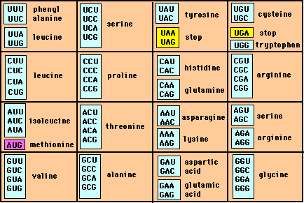
Genetic Code – Note degeneracy of 1st vs 2nd vs 3rd position sites

Slide 26
Genetic Code
Four-fold degenerate site – Any substitution is synonymous
From: mentor.lscf.ucsb.edu/course/spring/eemb102/lecture/Lecture7.ppt

Slide 27
Genetic Code
Two-fold degenerate site – Some substitutions synonymous, some
non-synonymous
From: mentor.lscf.ucsb.edu/course/spring/eemb102/lecture/Lecture7.ppt

Slide 28
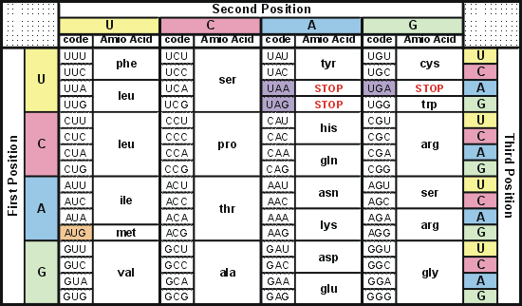
Degeneracy of 1st vs 2nd vs 3rd position sites results in 25.5% synonymous changes and 74.5% non synonymous changes (Yang&Nielsen,1998).
Genetic Code
Notes:
An inspection of the genetic code table suggests most changes at the first position are nonsynonymous, all changes at the second codon position are nonsynonymous and only some changes at the third position are synonymous. As a result we do not expect to see equal proportions of synonymous and nonsynonymous mutations even if there is no selection at protein level. Indeed, if mutations from any one nucleotide to any other occur at the same rate , we expect 25.5% of mutations to be synonymous and 74.5% mutations to be nonsynonymous.

Slide 29
Measuring Selection on Genes
Null hypothesis = neutral evolution
Under neutral evolution, synonymous changes should accumulate at a rate equal to mutation rate
Under neutral evolution, amino acid substitutions should also accumulate at a rate equal to the mutation rate
From: mentor.lscf.ucsb.edu/course/spring/eemb102/lecture/Lecture7.ppt

Slide 30
Counting #s/#a
Ser Ser Ser Ser Ser
Species1 TGA TGC TGT TGT TGT
Ser Ser Ser Ser Ala
Species2 TGT TGT TGT TGT GGT
#s = 2 sites
#a = 1 site
#a/#s=0.5
To assess selection pressures one needs to calculate the rates (Ka, Ks), i.e. the occurring substitutions as a fraction of the possible syn. and nonsyn. substitutions.
Things get more complicated, if one wants to take transition transversion ratios and codon bias into account. See chapter 4 in Nei and Kumar, Molecular Evolution and Phylogenetics.
Modified from: mentor.lscf.ucsb.edu/course/spring/eemb102/lecture/Lecture7.ppt

Slide 31
Testing for selection using dN/dS ratio
dN/dS ratio (aka Ka/Ks or ω (omega) ratio) where
dN = number of non-synonymous substitutions /
number of all possible non-synonymous substitutions
dS = number of synonymous substitutions /
number of all possible synonymous substitutions
dN/dS >1 positive, Darwinian selection
dN/dS =1 neutral evolution
dN/dS <1 negative, purifying selection
Notes:
The synonymous and non-synonymous rates dN and dS are defined as the numbers of synonymous and nonsynonymous substitutions per site. The ratio of the two rates omega=dN/dS then measures selective pressure at the protein level. If selection level has no effect on fitness, nonsynonymous mutations will be fixed at the same rate as synonymous mutations so that dN=dS and omega=1. If nonsynonymous mutations are deleterious purifying selection will reduce their fixation rate so that dN<dS and omega<1. If nonsynonymous mutations are favored by Darwinian selection, they will be fixed at a higher rate than synonymous mutations resulting in dN>dS and omega>1.

Slide 32
dambe
Two programs worked well for me to align nucleotide sequences based on the amino acid alignment,
One is DAMBE (only for windows). This is a handy program for a lot of things, including reading a lot of different formats, calculating phylogenies, it even runs codeml (from PAML) for you.
The procedure is not straight forward, but is well described on the help pages. After installing DAMBE go to HELP -> general HELP -> sequences -> align nucleotide sequences based on …->
If you follow the instructions to the letter, it works fine.
DAMBE also calculates Ka and Ks distances from codon based aligned sequences.

Slide 33
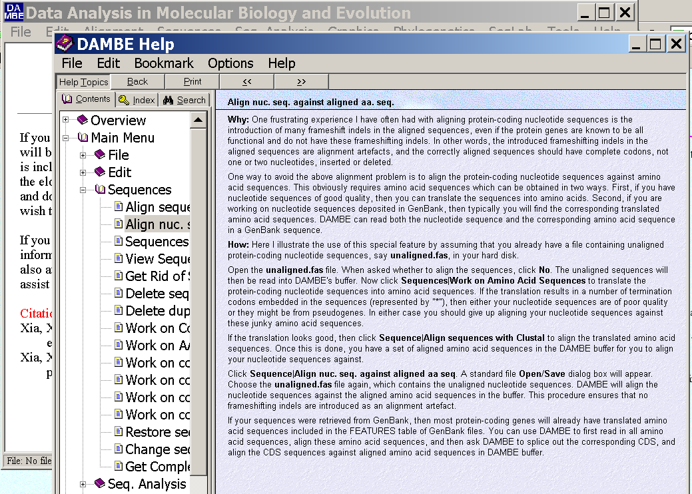
dambe (cont)

Slide 34
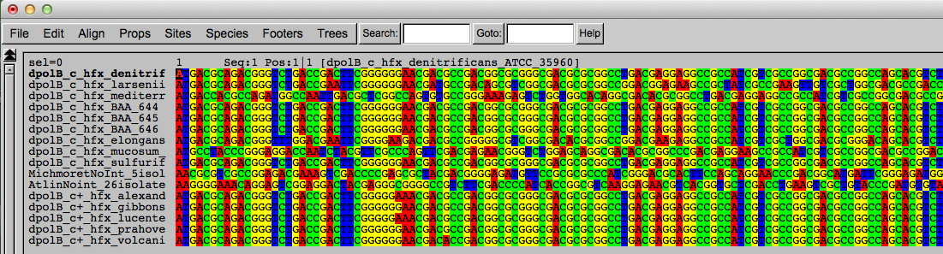
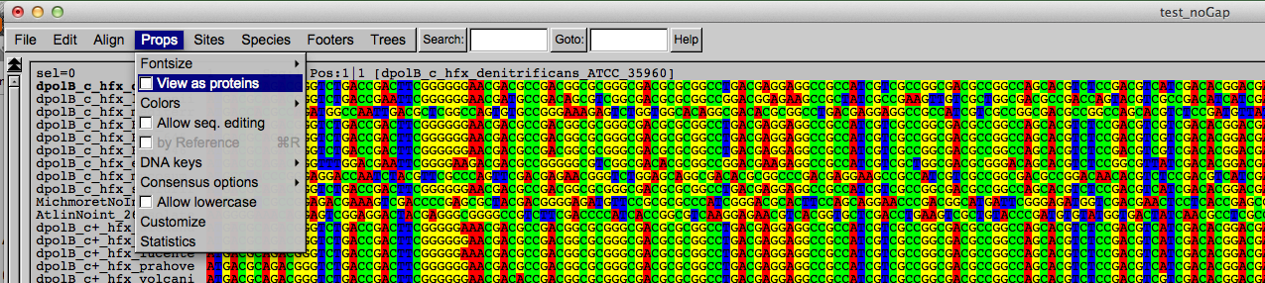
Codon based alignments in Seaview
Load nucleotide sequences (no gaps in sequences, sequence starts with nucleotide corresponding to 1st codon position)
Select view as proteins

Slide 35
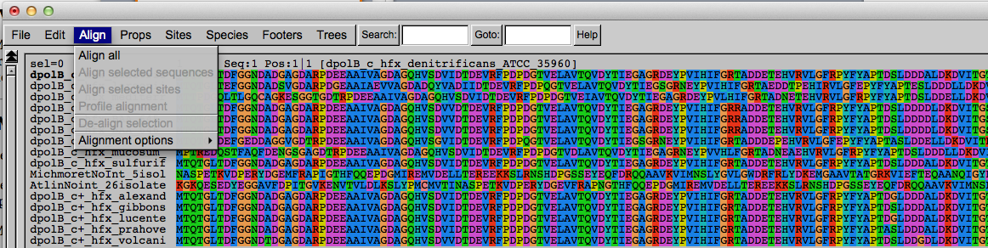
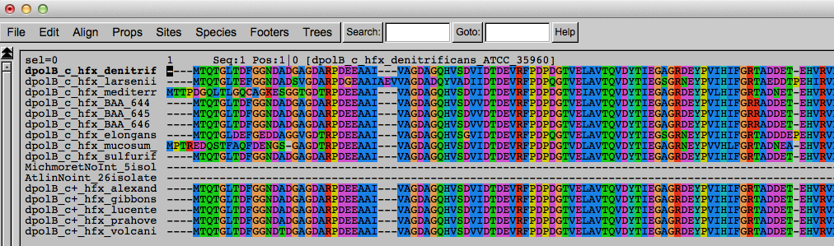
Codon based alignments in Seaview
With the protein sequences displayed, align sequences
Select view as nucleotides

Slide 36
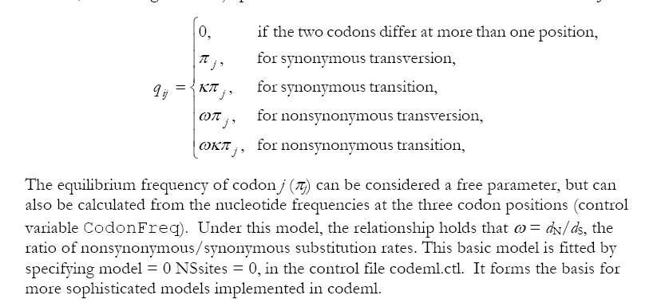
PAML (codeml) the basic model
Paml is available from the author at
http://abacus.gene.ucl.ac.uk/software/paml.html

Slide 37

sites versus branches
You can determine omega for the whole dataset; however, usually not all sites in a sequence are under selection all the time.
PAML (and other programs) allow to either determine omega for each site over the whole tree, ,
or determine omega for each branch for the whole sequence,
.
It would be great to do both, i.e., conclude codon 176 in the vacuolar ATPases was under positive selection during the evolution of modern humans – alas, a single site often does not provide much statistics.
PAML does provide a branch site model.

Slide 38
PAML – codeml – sites model (cont.)
the program is invoked by typing codeml followed by the name of a control file that tells the program what to do.
paml can be used to find the maximum likelihood tree, however, the program is rather slow. Phyml is a better choice to find the tree, which then can be used as a user tree.
An example for a codeml.ctl file is codeml.hv1.sites.ctl
This file directs codeml to run three different models:
one with an omega fixed at 1, a second where each site can be either have an omega between 0 and 1, or an omega of 1, and third a model that uses three omegas as described before for MrBayes.
The output is written into a file called Hv1.sites.codeml_out (as directed by the control file).
Point out log likelihoods and estimated parameter line (kappa and omegas)
Additional useful information is in the rst file generated by the codeml
Discuss overall result.

Slide 39
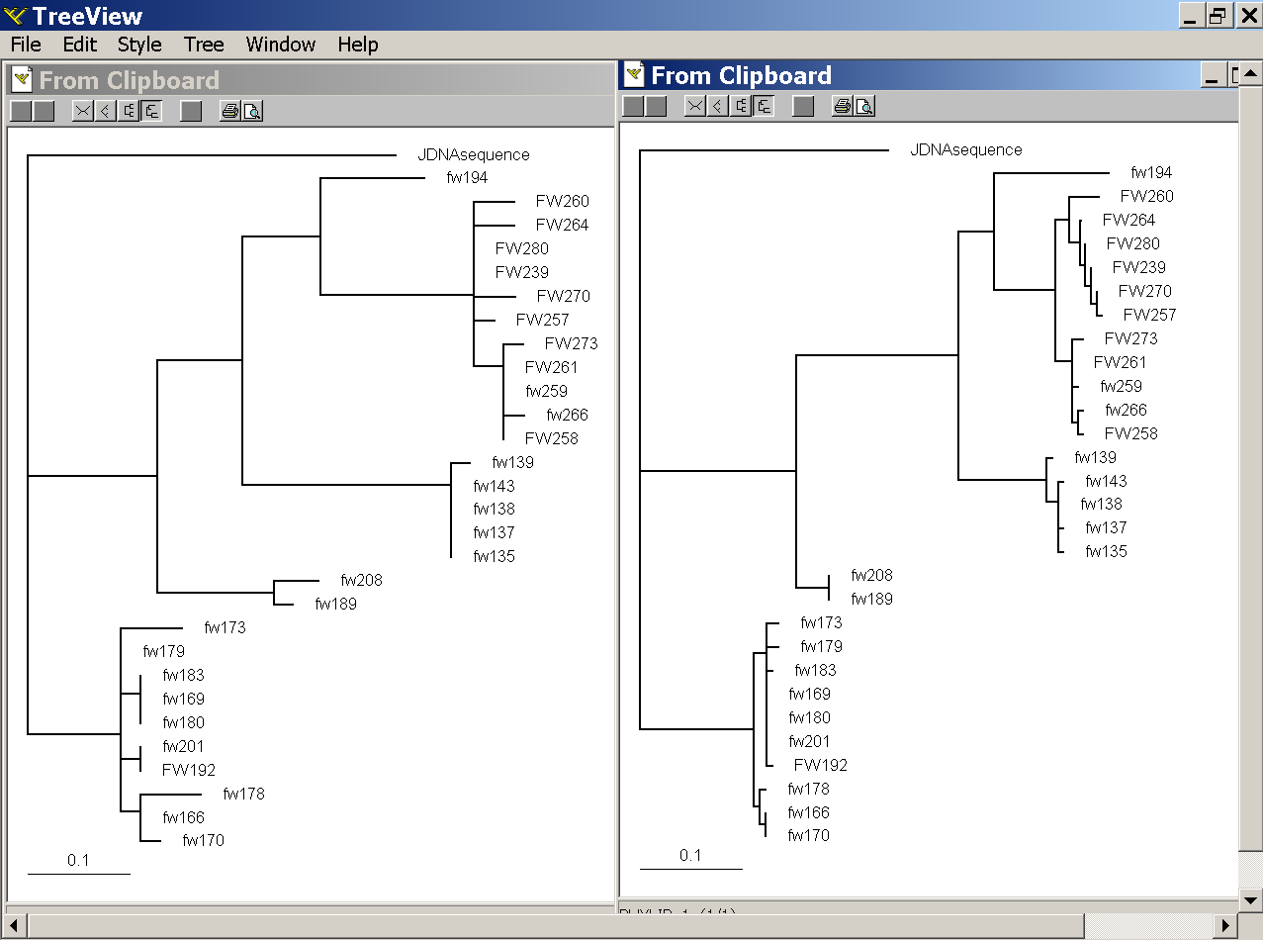
PAML – codeml – branch model
dS -tree
dN -tree

Slide 40
where to get help
read the manuals and help files
check out the discussion board at
https://www.ucl.ac.uk/discussions/viewforum.php?f=54
pal2nal: http://www.bork.embl.de/pal2nal/
else
there is a new program on the block called hy-phy
(=hypothesis testing using phylogenetics).
The easiest is probably to run the analyses on the authors datamonkey.

Slide 41
Sites model(s)
have been shown to work great in few instances.
The most celebrated case is the influenza virus HA gene.
A talk by Walter Fitch (slides and sound) on the evolution of
this molecule is here .
This article by Yang et al, 2000 gives more background on ml aproaches to measure omega. The dataset used by Yang et al is here: flu_data.paup .

Slide 42
sites model in MrBayes
The MrBayes block in a nexus file might look something like this:
begin mrbayes;
set autoclose=yes;
lset nst=2 rates=gamma nucmodel=codon omegavar=Ny98;
mcmcp samplefreq=500 printfreq=500;
mcmc ngen=500000;
sump burnin=50;
sumt burnin=50;
end;

Slide 43
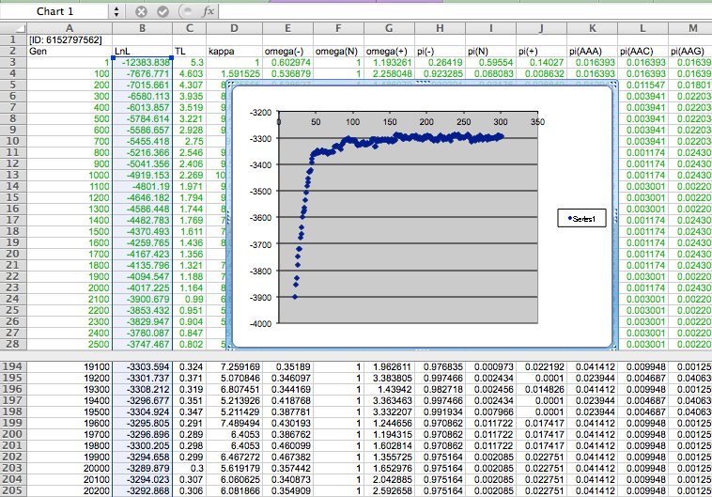

Slide 44
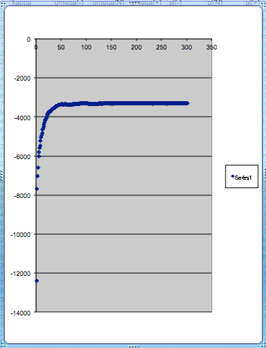
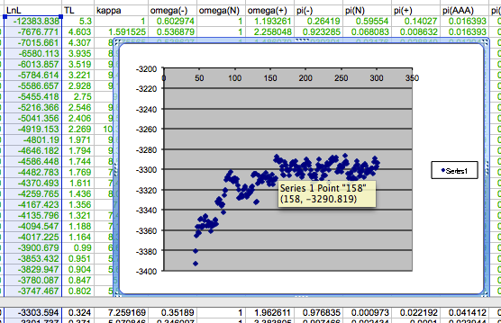
plot LogL to determine which samples to ignore
the same after rescaling the y-axis

Slide 45
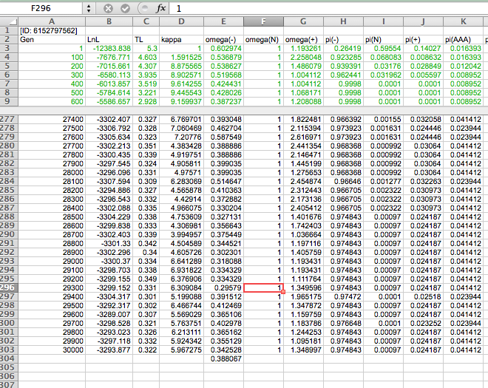

Slide 46
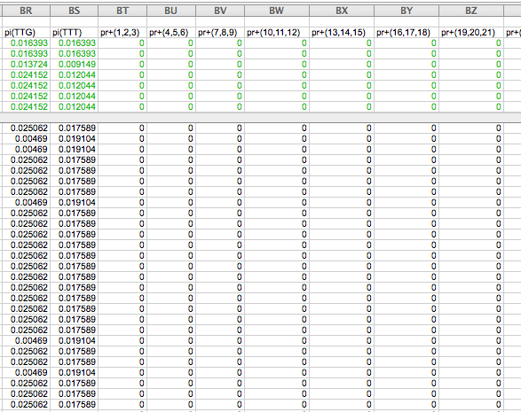

Slide 47
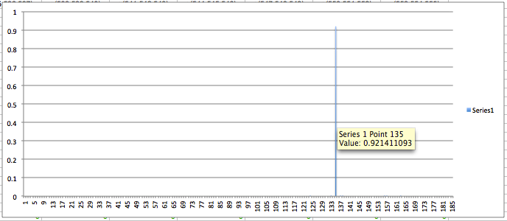
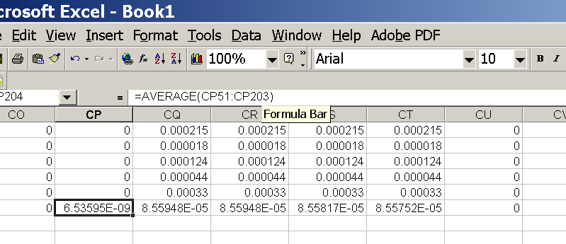
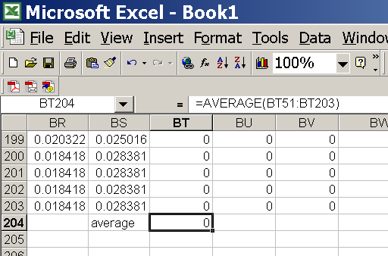
for each codon calculate the the average probability
copy paste formula
plot row
enter formula

Slide 48
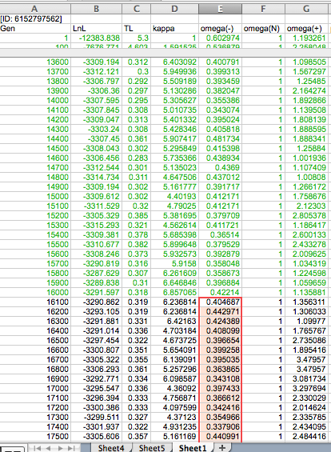
To determine credibility interval for a parameter (here omega<1):
Select values for the parameter, sampled after the burning.
Copy paste to a new spreadsheet,

Slide 49
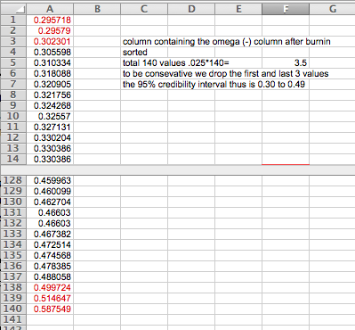
Sort values according to size,
Discard top and bottom 2.5%
Remainder gives 95% credibility interval.

Slide 50
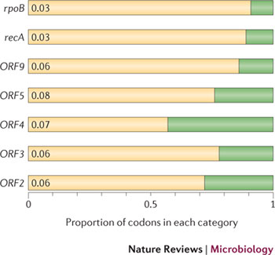
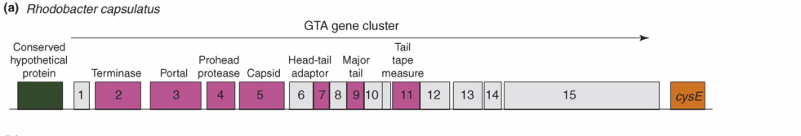
Purifying selection in GTA genes
dN/dS <1 for GTA genes has been used to infer selection for function
GTA genes
Lang AS, Zhaxybayeva O, Beatty JT. Nat Rev Microbiol. 2012 Jun 11;10(7):472-82
Lang, A.S. & Beatty, J.T. Trends in Microbiology , Vol.15, No.2 , 2006
Notes:
The ratio of non-synonymous-to-synonymous (dN/dS, or ω) codon substitution rates can be used as an indication of the selective pressure acting on a protein-coding gene. If a gene (or gene segment) is under purifying selection, non-synonymous mutations (that is, mutations resulting in a change of the encoded amino acid) will be selected against, resulting in ω < 1. In neutrally evolving proteins, synonymous and non-synonymous mutations will be fixed at approximately the same rate, resulting in ω = 1. Because different regions of a protein-coding gene may be under different selective constraints, codons can be divided into two categories: those with ω < 1 (yellow; the estimated ω is indicated on the bar) and those with ω fixed to 1 (green); the estimated proportion of codons in each category is given on the horizontal axis.

Slide 51
Purifying selection in E.coli ORFans
dN-dS < 0 for some ORFan E. coli clusters seems to suggest they are functional genes.
Gene groups | Number | dN-dS>0 | dN-dS<0 | dN-dS=0
E. coli ORFan clusters | 3773 | 944 (25%) | 1953 (52%) | 876 (23%)
Clusters of E.coli sequences found in Salmonella sp., Citrobacter sp. | 610 | 104 (17%) | 423(69%) | 83 (14%)
Clusters of E.coli sequences found in some Enterobacteriaceae only | 373 | 8 (2%) | 365 (98%) | 0 (0%)
Adapted after Yu, G. and Stoltzfus, A. Genome Biol Evol (2012) Vol. 4 1176-1187

Slide 52
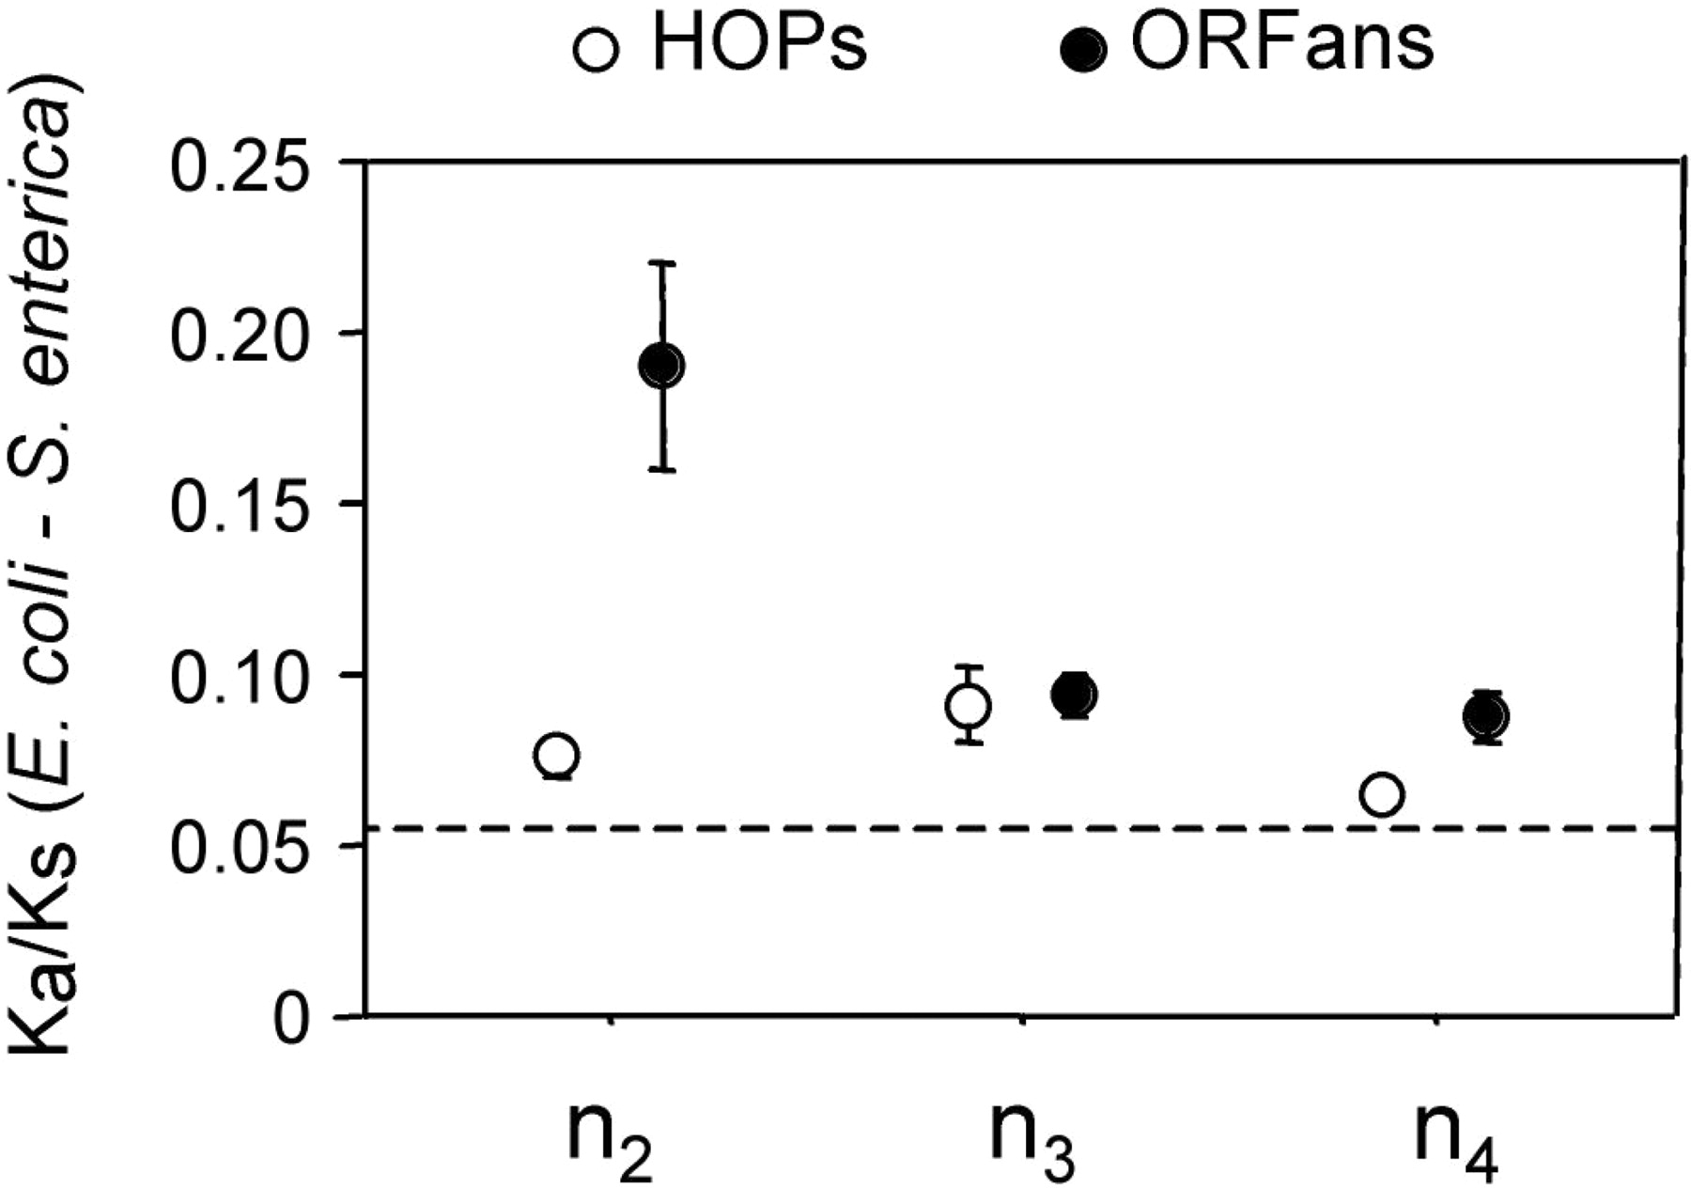
Vincent Daubin and Howard Ochman: Bacterial Genomes as New Gene Homes: The Genealogy of ORFans in E. coli. Genome Research 14:1036-1042, 2004
The ratio of non-synonymous to synonymous substitutions for genes found only in the E.coli - Salmonella clade is lower than 1, but larger than for more widely distributed genes.
Increasing phylogenetic depth
Fig. 3 from Vincent Daubin and Howard Ochman, Genome Research 14:1036-1042, 2004

Slide 53

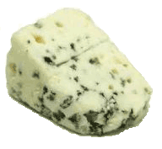
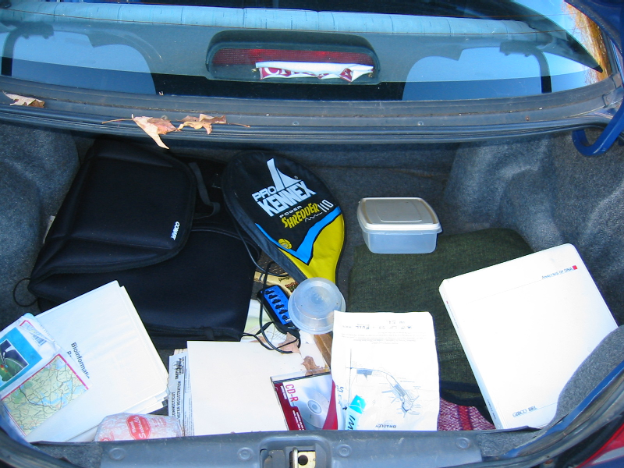
Trunk-of-my-car analogy: Hardly anything in there is the is the result of providing a selective advantage. Some items are removed quickly (purifying selection), some are useful under some conditions, but most things do not alter the fitness. See here for a published version.
Could some of the inferred purifying selection be due to the acquisition of novel detrimental characteristics (e.g., protein toxicity, HOPELESS MONSTERS)?

Slide 54
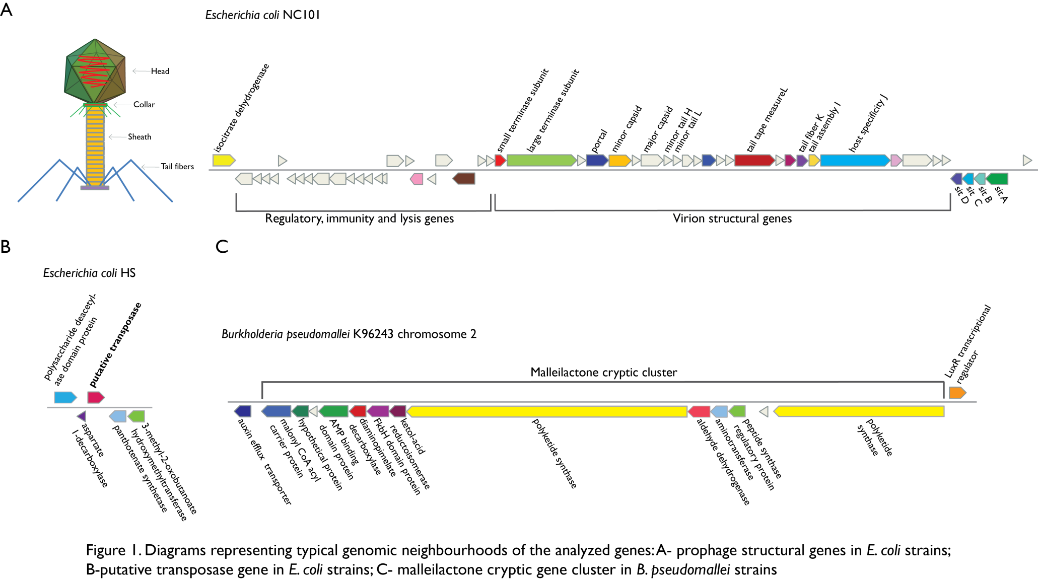
Vertically Inherited Genes Not Expressed for Function

Slide 55
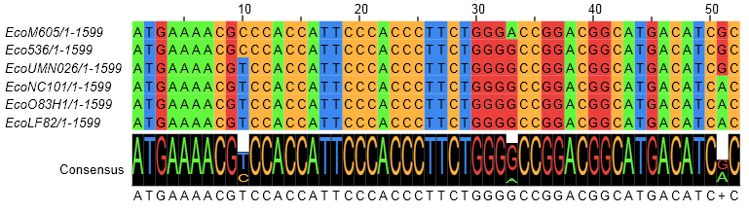
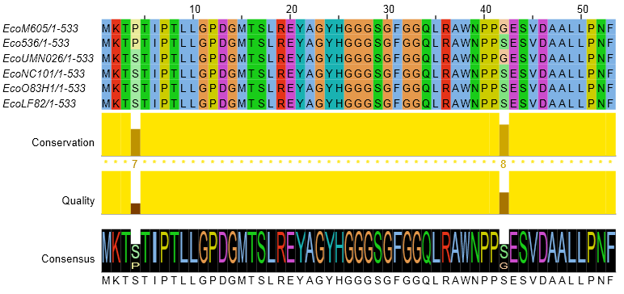
Counting Algorithm
Calculate number of different nucleotides/amino acids per MSA column (X)
Calculate number of nucleotides/amino acids substitutions (X-1)
Calculate number of synonymous changes
S=(N-1)nc-N
assuming N=(N-1)aa
X=2 1 nucleotide substitution
1 non-synonymous change
X=2 1 amino acid substitution

Slide 56
Simulation Algorithm
Calculate MSA nucleotide frequencies (%A,%T,%G,%C)
Introduce a given number of random substitutions ( at any position) based on inferred base frequencies
Compare translated mutated codon with the initial translated codon and count synonymous and non-synonymous substitutions

Slide 57
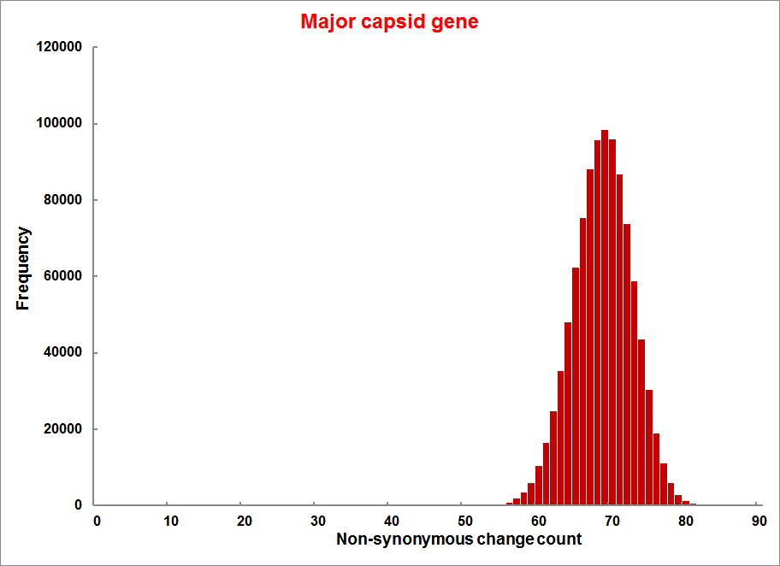
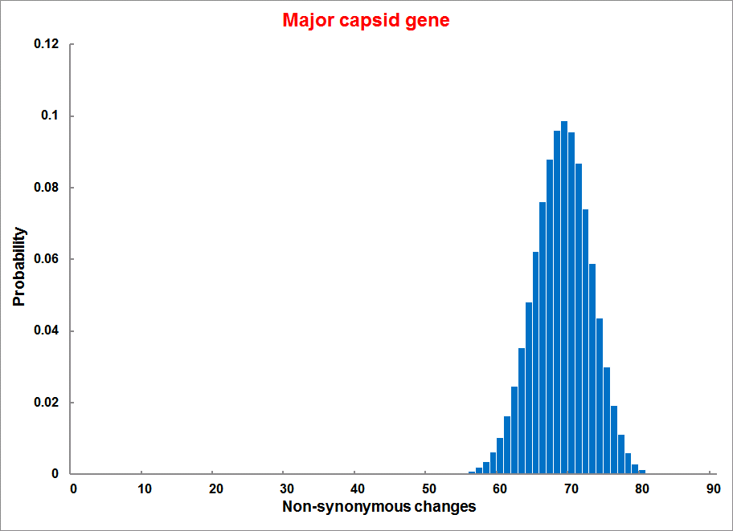
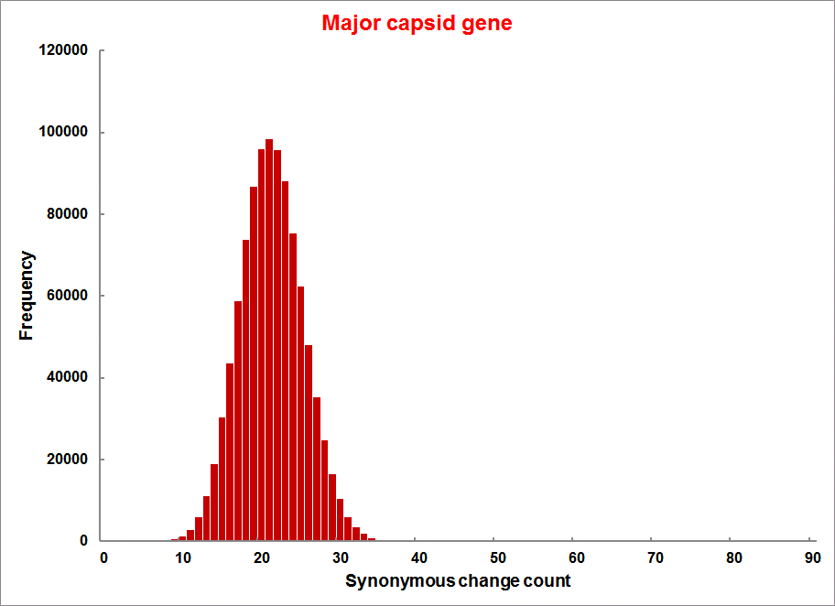
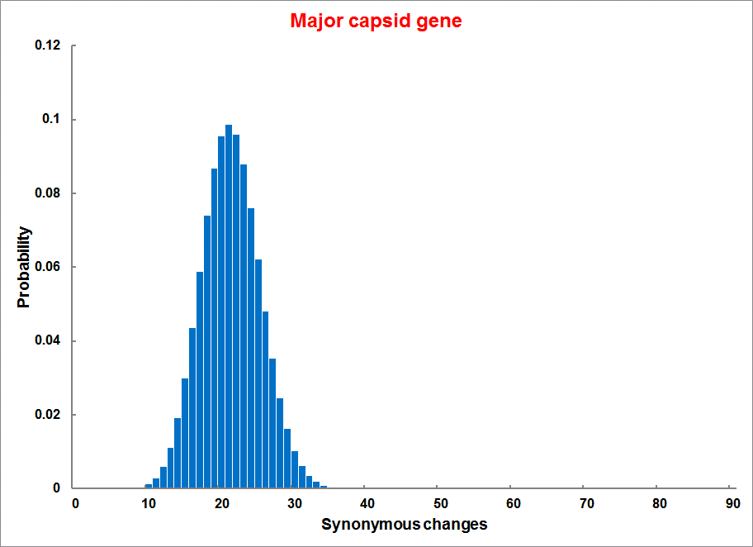
Evolution of Coding DNA Sequences Under a Neutral Model
E. coli Prophage Genes
Count distribution from simulations
Probability distribution
n=90
Non-synonymous
n= 90
k= 24
p=0.763
P(≤24)=3.63E-23
Observed=24
P(≤24) < 10⁻⁶
n=90
Synonymous
n= 90
k= 66
p=0.2365
P(≥66)=3.22E-23
Observed=66
P(≥66) < 10⁻⁶

Slide 58
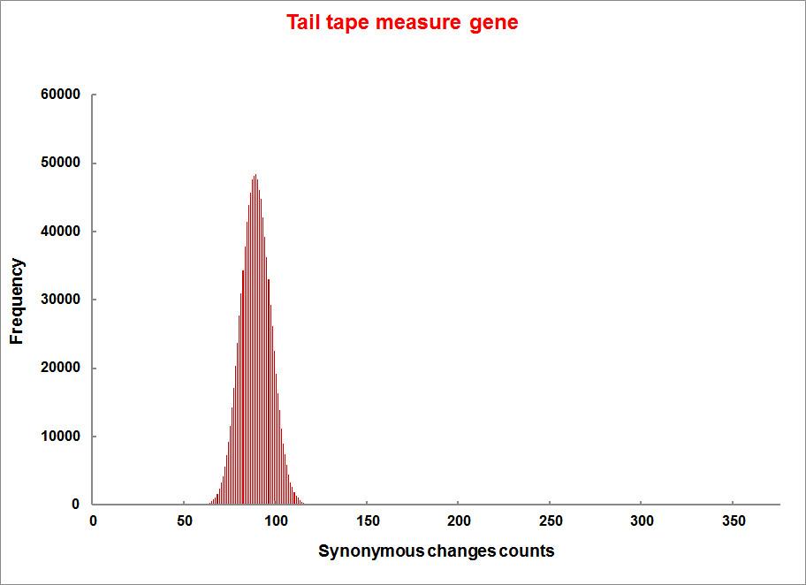



Evolution of Coding DNA Sequences Under a Neutral Model
E. coli Prophage Genes
Count distribution
Probability distribution
n=375
Synonymous
n= 375
k= 243
p=0.237
P(≥243)=7.92E-64
Observed=243
P(≥243) < 10⁻⁶
n=723
Synonymous
n= 723
k= 498
p=0.232
P(≥498)=6.41E-149
Observed=498
P(≥498) < 10⁻⁶

Slide 59
Evolution of Coding DNA Sequences Under a Neutral Model
E. coli Prophage Genes
 |  | OBSERVED |  | SIMULATED |  | Dnapars | Simulated | Codeml
Gene | Alignment Length (bp) | Substitutions | Synonymous changes* | Substitutions | p-value synonymous (given *) | Minimum number of substitutions | dN/dS | dN/dS
Major capsid | 1023 | 90 | 66 | 90 | 3.23E-23 | 94 | 0.113 | 0.13142
Minor capsid C | 1329 | 81 | 59 | 81 | 1.98E-19 | 84 | 0.124 | 0.17704
Large terminase subunit | 1923 | 75 | 67 | 75 | 7.10E-35 | 82 | 0.035 | 0.03773
Small terminase subunit | 543 | 100 | 66 | 100 | 1.07E-19 | 101 | 0.156 | 0.25147
Portal | 1599 | 55 | 46 | 55 | 1.36E-21 | *64 | 0.057 | 0.08081
Protease | 1329 | 55 | 37 | 55 | 4.64E-11 | 55 | 0.162 | 0.24421
Minor tail H | 2565 | 260 | 168 | 260 | 1.81E-44 | 260 | 0.17 | 0.30928
Minor tail L | 696 | 30 | 26 | 30 | 1.30E-13 | 30 | 0.044 | 0.05004
Host specificity J | 3480 | 723 | 498 | 723 | 6.42E-149 | *773 | 0.137 | 0.17103
Tail fiber K | 741 | 41 | 28 | 41 | 1.06E-09 | 44 | 0.14 | 0.18354
Tail assembly I | 669 | 39 | 33 | 39 | 3.82E-15 | 40 | 0.064 | 0.07987
Tail tape measure protein | 2577 | 375 | 243 | 375 | 7.92E-64 | 378 | 0.169 | 0.27957
Values well under the p=0.01 threshold, suggesting rejection of the null hypothesis of neutral evolution of prophage sequences.

Slide 60
Evolution of Coding DNA Sequences Under a Neutral Model
B. pseudomallei Cryptic Malleilactone Operon Genes and
E. coli transposase sequences
 |  | OBSERVED |  | SIMULATED
Gene | Alignment Length (bp) | Substitutions | Synonymous changes* | Substitutions | p-value synonymous (given *)
Aldehyde dehydrogenase | 1544 | 13 | 3 | 13 | 4.67E-04
AMP- binding protein | 1865 | 9 | 6 | 9 | 1.68E-02
Adenosylmethionine-8-amino-7-oxononanoate aminotransferase | 1421 | 20 | 12 | 20 | 6.78E-04
Fatty-acid CoA ligase | 1859 | 13 | 2 | 13 | 8.71E-01
Diaminopimelate decarboxylase | 1388 | 7 | 3 | 7 | 6.63E-01
Malonyl CoA-acyl transacylase | 899 | 2 | 1 | 2 | 4.36E-01
FkbH domain protein | 1481 | 17 | 9 | 17 | 2.05E-02
Hypothethical protein | 431 | 3 | 2 | 3 | 1.47E-01
Ketol-acid reductoisomerase | 1091 | 2 | 0 | 2 | 1.00E+00
Peptide synthase regulatory protein | 1079 | 10 | 5 | 10 | 8.91E-02
Polyketide-peptide synthase | 12479 | 135 | 66 | 135 | 4.35E-27
 |  | OBSERVED |  | SIMULATED
Gene | Alignment Length (bp) | Substitutions | Synonymous changes* | Substitutions | p-value synonymous (given *)
Putative transposase | 903 | 175 | 107 | 175 | 1.15E-29

Slide 61
Other ways to detect positive selection
Selective sweeps -> fewer alleles present in population
(see contributions from archaic Humans for example)
Repeated episodes of positive selection -> high dN
(works well for repeated positive – aka diversifying – selection; e.g. virus interaction with the immunesystem)

Slide 62
Other ways to detect positive selection
Selective sweeps -> fewer alleles present in population
(allele shows little within allele divergence - see contributions from archaic Humans for example),
SNP or neighboring SNPs are at higher frequency within a population.
Repeated episodes of positive selection -> high dN

Slide 63

Fig. 1 Current world-wide frequency distribution of CCR5-Δ32 allele frequencies. Only the frequencies of Native populations have been evidenced in Americas, Asia, Africa and Oceania. Map redrawn and modified principally from <ce:cross-ref refid="bib5"> B...
Eric Faure , Manuela Royer-Carenzi
Is the European spatial distribution of the HIV-1-resistant CCR5-Δ32 allele formed by a breakdown of the pathocenosis due to the historical Roman expansion?
Infection, Genetics and Evolution, Volume 8, Issue 6, 2008, 864 - 874
http://dx.doi.org/10.1016/j.meegid.2008.08.007

Slide 64

Geographic origin of the three populations studied.
196,524 SNPs
-> PCA
Hafid Laayouni et al. PNAS 2014;111:2668-2673
©2014 by National Academy of Sciences
Notes:
Geographic origin of the three populations studied. (A) European/Romanians and Rroma/Gipsy share the same location, even if the origin of the latter is in North India. (B) Plot of the populations under analysis according to the coordinates to the two main eigenvectors of smartpca (Eigensoft) analysis, in which each dot represents an individual. Individuals within the circles and the same color have been considered for the study; those of different colors represent false population allocation and those intermediate represent admixed individuals. ROM, nongypsy Romanians; INDI, individuals from North India; GYP, Rroma/Gypsies living in Romania.

Slide 65

Manhattan plot of results of selection tests in Rroma, Romanians, and Indians using TreeSelect statistic (A) and XP-CLR statistic (B).
SNP frequencies within and between populations
selective sweeps detected through linkage disequilibrium
Laayouni H et al. PNAS 2014;111:2668-2673
Convergent evolution in European and Rroma populations reveals pressure exerted by plague on Toll-like receptors.
©2014 by National Academy of Sciences
Notes:
Manhattan plot of results of selection tests in Rroma, Romanians, and Indians using TreeSelect statistic (A) and XP-CLR statistic (B). Chromosomes ordered from chromosome 1 to chromosome 22.

Slide 66

Variant arose about
5800 years ago

Slide 67

The age of haplogroup D was found to be ~37,000 years

Slide 68



Slide 69


Fig. 6 Four possible scenarios of genetic mixture involving Neandertals.
R E Green et al. Science 2010;328:710-722
Published by AAAS
Notes:
Four possible scenarios of genetic mixture involving Neandertals. Scenario 1 represents gene flow into Neandertal from other archaic hominins, here collectively referred to as Homo erectus. This would manifest itself as segments of the Neandertal genome with unexpectedly high divergence from present-day humans. Scenario 2 represents gene flow between late Neandertals and early modern humans in Europe and/or western Asia. We see no evidence of this because Neandertals are equally distantly related to all non-Africans. However, such gene flow may have taken place without leaving traces in the present-day gene pool. Scenario 3 represents gene flow between Neandertals and the ancestors of all non-Africans. This is the most parsimonious explanation of our observation. Although we detect gene flow only from Neandertals into modern humans, gene flow in the reverse direction may also have occurred. Scenario 4 represents old substructure in Africa that persisted from the origin of Neandertals until the ancestors of non-Africans left Africa. This scenario is also compatible with the current data.

Slide 70



Slide 71

Figure 1 Denisovan Genetic Material as a Fraction of that in New Guineans Populations are only shown as having Denisova ancestry if the estimates are more than two standard errors from zero (we combine estimates for populations in this study wit...
David Reich , Nick Patterson , Martin Kircher , Frederick Delfin , Madhusudan?R. Nandineni , Irina Pugach , Albert...
Denisova Admixture and the First Modern Human Dispersals into Southeast Asia and Oceania
The American Journal of Human Genetics Volume 89, Issue 4 2011 516 - 528
http://dx.doi.org/10.1016/j.ajhg.2011.09.005

Slide 72

Did the Denisovans Cross Wallace's Line?
Science 18 October 2013:
vol. 342 no. 6156 321-323
Ancient migrations.
The proportions of Denisovan DNA in modern human populations are shown as red in pie charts, relative to New Guinea and Australian Aborigines (3). Wallace's Line (8) is formed by the powerful Indonesian flow-through current (blue arrows) and marks the limit of the Sunda shelf and Eurasian placental mammals.

Slide 73

Figure 3 A Model of Population Separation and Admixture that Fits the Data The admixture graph suggests Denisova-related gene flow into a common ancestral population of Mamanwa, New Guineans, and Australians, followed by admixture of New Guinean...
David Reich , Nick Patterson , Martin Kircher , Frederick Delfin , Madhusudan R. Nandineni , Irina Pugach , Albert...
Denisova Admixture and the First Modern Human Dispersals into Southeast Asia and Oceania
The American Journal of Human Genetics Volume 89, Issue 4 2011 516 - 528
http://dx.doi.org/10.1016/j.ajhg.2011.09.005

Slide 74

Archaic human admixture with modern Homo sapiens
From: http://en.wikipedia.org/wiki/Archaic_human_admixture_with_modern_Homo_sapiens

Slide 75
“Genotyping of a DNA sample that was submitted to a commercial genetic-testing facility demonstrated that the Y chromosome of this African American individual carried the ancestral state of all known Y chromosome SNPs.”
Mendez , et al. 2013
An African American Paternal Lineage Adds an Extremely Ancient Root to the Human Y Chromosome Phylogenetic Tree
The American Journal of Human Genetics Volume 92, Issue 3 2013 454 - 459
http://dx.doi.org/10.1016/j.ajhg.2013.02.002

Slide 76

Figure 1 Genealogy of A00, A0, and the Reference Sequence Lineages on which mutations were identified and lineages that were used for placing those mutations on the genealogy are indicated with thick and thin lines, respectively. The numbers of ...
Mendez , et al. 2013
An African American Paternal Lineage Adds an Extremely Ancient Root to the Human Y Chromosome Phylogenetic Tree
The American Journal of Human Genetics Volume 92, Issue 3 2013 454 - 459
http://dx.doi.org/10.1016/j.ajhg.2013.02.002

Slide 77

Figure 2 Map Showing Cameroon and the Approximate Location where Mbo Speakers Live
Fernando L. Mendez , Thomas Krahn , Bonnie Schrack , Astrid-Maria Krahn , Krishna R. Veeramah , August E. Woerner ...
An African American Paternal Lineage Adds an Extremely Ancient Root to the Human Y Chromosome Phylogenetic Tree
The American Journal of Human Genetics Volume 92, Issue 3 2013 454 - 459
http://dx.doi.org/10.1016/j.ajhg.2013.02.002

Slide 78
For more discussion on archaic and early humans see:
http://en.wikipedia.org/wiki/Denisova_hominin
http://www.nytimes.com/2012/01/31/science/gains-in-dna-are-speeding-research-into-human-origins.html
http://www.nytimes.com/2014/10/23/science/research-humans-interbred-with-neanderthals.html?
http://www.sciencedirect.com/science/article/pii/S0002929711003958
http://www.abc.net.au/science/articles/2012/08/31/3580500.htm
http://www.sciencemag.org/content/334/6052/94.full
http://www.sciencemag.org/content/334/6052/94/F2.expansion.html
http://haplogroup-a.com/Ancient-Root-AJHG2013.pdf

Slide 79



How do you define evolution?
Richard Goldschmidt 1940
hopeful monsters
Mutationism HGT/WGD!
Punctuated Equilibrium
Few genes / large effect
Vilified by Mayr, celebrated 1977 Gould & Evo-devo
Ernst Mayr 1942
NeoDarwinian Synthesis
Natural Selection
Gradualism
Many genes/small effect
Dario – “Fisher right”
Motoo Kimura 1968
Neutral Theory
Genetic Drift is main force for changing allele frequencies
Slide from Chris Pires
Notes:
Goldschmitdt,R. (1940). The Material Basis of Evolution
Mayr, Ernst (1942). Systematics and the origin of species, from the viewpoint of a zoologist

Slide 80

Duplications and Evolution
Ohno postulated that gene duplication plays a major role in evolution
Small scale duplications (SSD)
Whole genome duplications (WGD)
Polyploid: nucleus contains three or more copies of each chromosome
Autopolyploid: formed within a single species
Diploids AA and A’A’ Polyploid AAA’A’
Allopolyploid: formed from more than one species
Diploids AA and BB Polyploid AABB
Susumu Ohno 1970
Evolution by gene duplication
1R and 2R hypothesis
“Junk DNA” 1972
Slide from Chris Pires

Slide 81


e.g. gene duplications in yeast
from Benner et al., 2002
Figure 1. The number of duplicated gene pairs (vertical axis) in the genome of the yeast Saccharomyces cerevisiae versus f₂, a metric that models divergence of silent positions in twofold redundant codon systems via an approach-to-equilibrium kinetic process and therefore acts as a logarithmic scale of the time since the duplications occurred. Recent duplications are represented by bars at the right. Duplications that diverged so long ago that equilibrium at the silent sites has been reached are represented by bars where f₂ 0.55. Noticeable are episodes of gene duplication between the two extremes, including a duplication at f₂ 0.84. This represents the duplication, at ~80 Ma, whereby yeast gained its ability to ferment sugars found in fruits created by angiosperms. Also noticeable are recent duplications of genes that enable yeast to speed DNA synthesis, protein synthesis, and malt degradation, presumably representing yeast's recent interaction with humans.
The chemical pathway that converts glucose to alcohol in yeast arose ~80 Ma, near the time that fermentable fruits became dominant. Gene families that suffered duplication near this time, captured in the episode of gene duplication represented in the histogram in Fig. 1 by bars at f₂ 0.84, are named in red. According to the hypothesis, this pathway became useful to yeast when angiosperms (flowering, fruiting plants) began to provide abundant sources of fermentable sugar in their fruits.

Slide 82

Gene Transfer, Sex, and Recombination:
Inventions do not need to be made sequentially
Gene transfer, followed by homologous or non-homologous recombination, allows inventions to be shared across the tree of life

Slide 83
Aside: Gene and genome duplication versus
Horizontal Gene Transfer
Autochtonous gene/genome
duplication are rare
in prokaryotes
Gene family expansion through horizontal gene transfer –
the most common process in prokaryotes

Slide 84

Horizontal Gene Transfer (HGT) and the
Acquisition of New Capabilities
Most important process to adapt microorganisms to new environments.
E.g.: Antibiotic and heavy metal resistance,
pathways that allow acquisition and breakdown of new substrates.
Creation of new metabolic pathways.
HGT not autochthonous gene duplication is the main
process of gene family expansion in prokaryotes.
Also important in the recent evolution of multicellular eukaryotes
(HGT between fish species and between grasses).
Selection acts on the Holobiont (= Host + Symbionts)
To adapt to new conditions, new symbionts can be acquired, or existing symbionts can acquire new genes through HGT.

Slide 85





Gene Transfer in Eukaryotes
Bacterial parasites on red algae
HGT
Human gut symbiont

Slide 86

Gene Transfer in Eukaryotes – Example 2
Highlights
Key genes for C₄ photosynthesis were transmitted between distantly related grasses
These genes contributed to the adaptation of the primary metabolism
Their transmission was independent from most of the genome
Curr Biol. 2012 Mar 6;22(5):445-9. Epub 2012 Feb 16.
Adaptive Evolution of C(4) Photosynthesis
through Recurrent Lateral Gene Transfer.
Christin PA, Edwards EJ, Besnard G, Boxall SF, Gregory R, Kellogg EA, Hartwell J, Osborne CP.
Eric H. Roalson Current Biology Vol 22 No 5 R162

Slide 87

Gene Transfer in Eukaryotes – Example 2
From: Christin PA, Edwards EJ, Besnard G, Boxall SF, Gregory R, Kellogg EA, Hartwell J, Osborne CP.
Adaptive Evolution of C(4) Photosynthesis
through Recurrent Lateral Gene Transfer. Curr Biol. 2012 Mar 6;22(5):445-9. Epub 2012 Feb 16.

Slide 88


Gene Transfer in Eukaryotes – Example 3

Slide 89
HGT as a force creating new pathways

Slide 90

HGT as a force creating new pathways – Example I
Acetoclastic Methanogenesis
Unique to subset of Archaea
Energy production via reduction of multiple carbon substrates to CH₄
900 Million metric tons of biogenic methane produced annually.
Over 66% of biogenic methane is produced from acetate, mostly by Methanosarcina genera.
From: Galagan et al., 2002
Fournier and Gogarten (2008) Evolution of Acetoclastic Methanogenesis in Methanosarcina via Horizontal Gene Transfer from Cellulolytic Clostridia. J. Bacteriol. 190(3):1124-7

Slide 91


Clostridia acetigenic pathway
Methanosarcina
acetoclastic pathway
AckA
HGT
PtaA
PtaA
AckA
Figures drawn with Metacyc (www.metacyc.org)

Slide 92

HGT as a force creating new pathways – Example 2
Oxygen producing photosynthesis

